Slide 1
MARKETING & BRANDING
WITH A FESTIVE TWIST
Creating joyful experiences amongst our local communities

Slide 2
NNANNA OKPARA
FOUNDER

Slide 3
FESTIVE ICT
Event Production company that produces community events in Wichita and beyond.

Slide 9
Marketing and Branding with a Festive twist!

Slide 10
What is Marketing?

Slide 11
What is Marketing?
Marketing is the process of COMMUNICATING a product or service to a desired audience with the goal of making a sale.

Slide 12
What is Marketing?
“Marketing is doing work that matters for people who care.”
Seth Godin

Slide 13
What is Marketing?
“Marketing is understanding people, what they want and need and helping them meet their wants & needs.”
Nnanna Okpara

Slide 14
How do you understand people and meet their needs?
Ask questions
Ask more questions
Pay attention
Be observant
Tap into the culture
Listen
Be patient

Slide 15
What is Branding?

Slide 16
What is Branding?
Branding is the process of creating a strong positive perception of your company, and its products in your consumer’s mind.

Slide 17
What is Branding?
Brand Promise – A value or experience a company’s customers can expect to receive every single time they interact with that company.
A good brand promise is simple, unique, credible, memorable and inspiring.

Slide 18
What is Branding?
Can you Measure it?
If you can measure it, then you can manage it.

Slide 19
What is Branding?
If you can consistently deliver on your brand promise, your brand equity will rise and you will see adequate growth within your company

Slide 20
What is Branding?
Examples
Apple – Think Different
Amazon – Convenience
Nike – Greatness, Great Athletes

Slide 21
Festive ICT Brand Promise
Brand Promise - Creating joyful experiences in our local communities.
It is my job to create a memorable experience for as many attendees as possible.
The marketing of all Festive ICT events has to convey the overall message of the brand promise .
Promotional Materials, advertising and partnerships must be in line with the brand promise.
Notes:
Examples of things festive has done branding wise.

Slide 22
A Blueprint

Slide 23
What?
ICT PIZZA FEST

Slide 24
Why?
OPPORTUNITY
Food city
Need for more events & festivals
Young & developing entertainment scene
Home of worldwide recognized pizza brands
Exposure for local business

Slide 25
Marketing Strategy
CAMPAIGN LENGTH
12 weeks
GOAL
Sell 3000 tickets
SELLING POINTS
Product
Price
Location
CHANNELS
Social media
Publicity
Advertising
Email

Slide 26
Target audience
MARKET
Wichita, KS + 25 miles
TARGET AUDIENCE
Families
Event goers
Explorers
Foodies
Pizza lovers
AGE DEMOGRAPHICS
Males 25-45
Females – 18-35

Slide 27
Goal
Goal - 3000 Tickets
Early Bird Ticket Sales : 500 - 750
Pre-Sale Ticket Sale: 1500 -1750
Day of Event Ticket Sales : 500 - 1000

Slide 28
Selling Points - Product
15 Local Pizza Vendors
Variety of Pizza Options at $2 per slice
Local Beer & Wine
Delicious Desserts
Live Music by Popular Local Band
Kids Zone with Face Painting and Life Size Games
Vendor Competitions
Dough Tossing
Pizza Box Folding
Notes:
Opportunity -

Slide 29
Selling Points - Price
Pricing
Entry Ticket Prices
Early Bird Tickets - $5
Pre-Sale Tickets - $10
Day of Event Tickets - $15
Food Prices
Pizza Slice - $2

Slide 30
Selling Points - Location
Location – Exploration Place Festival Plaza
Outdoor
Spacious
Inviting
Easy Access
Adequate Parking

Slide 31
Channels
Social Media
Engaging content
Fun interactive promo videos
Ticket giveaways
Giveaway partnerships with vendors
Publicity
Local Influencers
Kake News
Denise Neil
Wichita by EB

Slide 32
Channels (cont’d)
Advertising
Local Radio
Billboards
Magazines
Blogs
Newsletters
Social Media Advertising

Slide 33
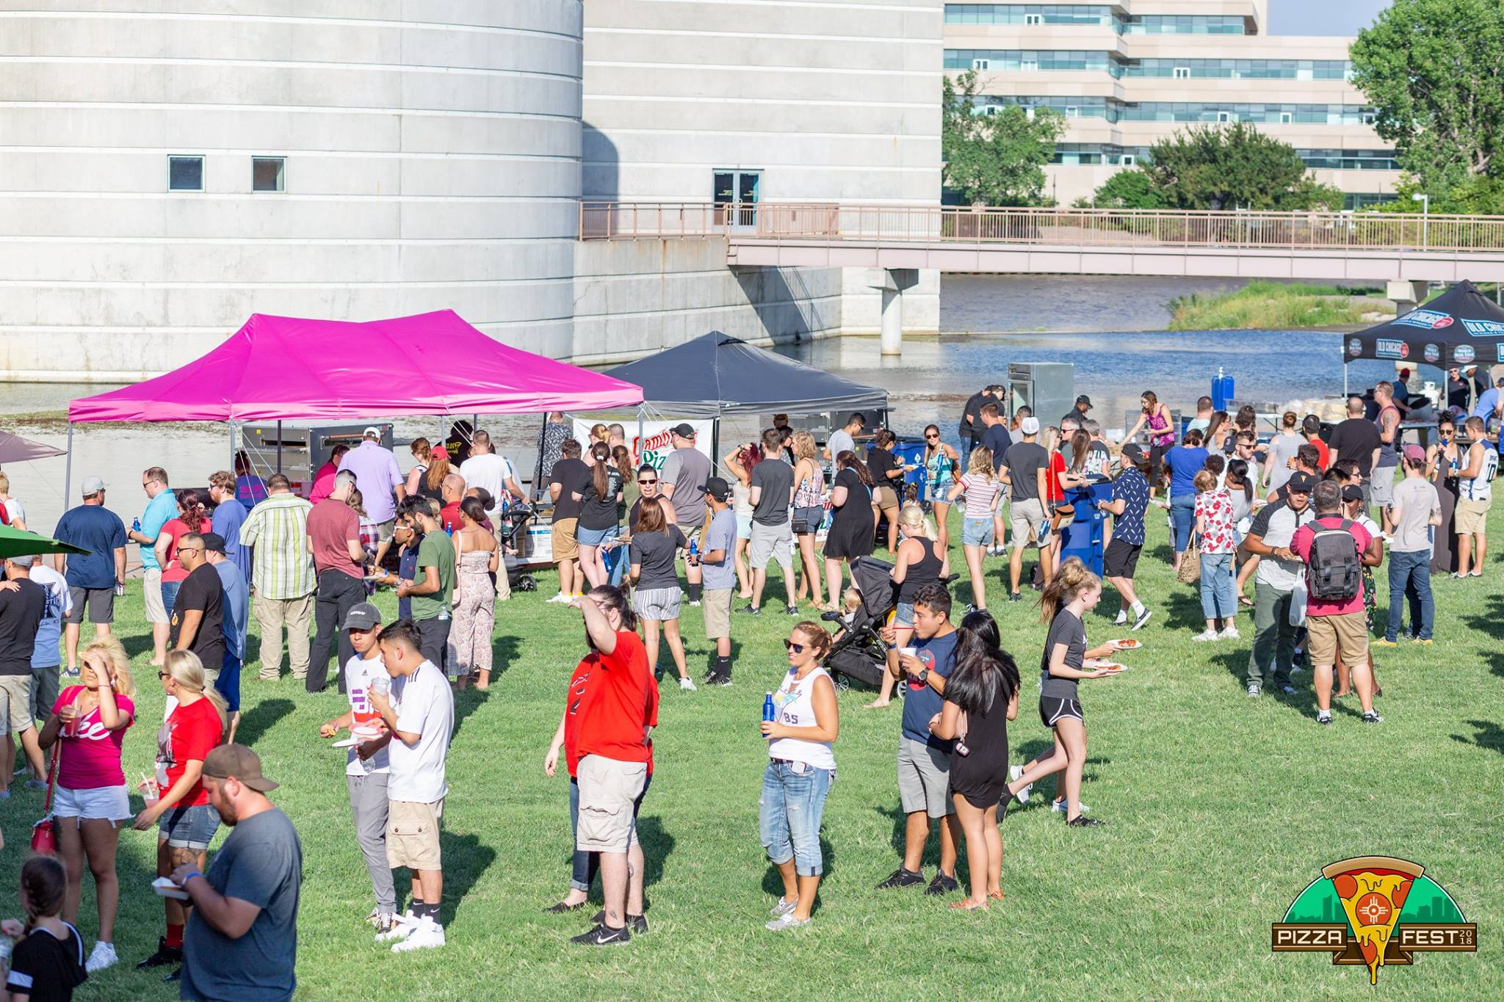
Results
Ticket Sales = 2000 (66% of our goal)
Social Media Reach = 121,000 impressions
Publicity Channels Utilized
Denise Neil (Wichita Eagle)
Wichita by Eb
Visit Wichita

Slide 34
Results (cont’d)
Advertising Channels Utilized
Pandora
Spotify
YouTube
Digital Billboards
Weekly Ads on Social Media
TV Ads on channels such as
E News
ESPN

Slide 35
Review
Efficiency of Campaign
What worked?
What didn’t work?
What do we need to double down on?
What can we improve on?

Slide 36
Summary
To be a great marketer you need to understand people, what they want and need and help them meet their wants and needs.
Focus on doing work that matters for people that care.
A Brand Promise should be simple, unique, credible, memorable and inspiring.
Publicity is a very important for an effective marketing strategy

Slide 37
THANK YOU

